Slide 1
Performance Architecture
Oren Eini
oren@ravendb.net

Slide 2

Context: RavenDB
Born: 2008
.NET 3.5 was out at the time
Fairly typical .NET web application
Rich .NET client API
Windows only limitation
NoSQL Document Database
REST API
Store JSON documents
Distributed
Queries

Slide 3
Timeline
Release notes:
Performance improvements
2008
Design
2009
Implementation
2010
1.0 release
Production deployments
2013
2.0 release
2014
3.0 release
2015
3.5 release

Slide 4

Can’t get it to be meaningfully faster
Too much going against us
GC time under load > 85%

Slide 5

Go back to start…
Can’t patch this any longer
Need to take drastic action
Dangerous
Business wise
2nd system syndrome

Slide 6

Goals
Must be at least 10x faster to be worth it
Must have the same set of features
Learn from what didn’t work / made our lives hard
Give up strict backward compatibility
That was a mistake

Slide 7


How to be fast?
Do less?
Be smarter?
Promise less?

Slide 8
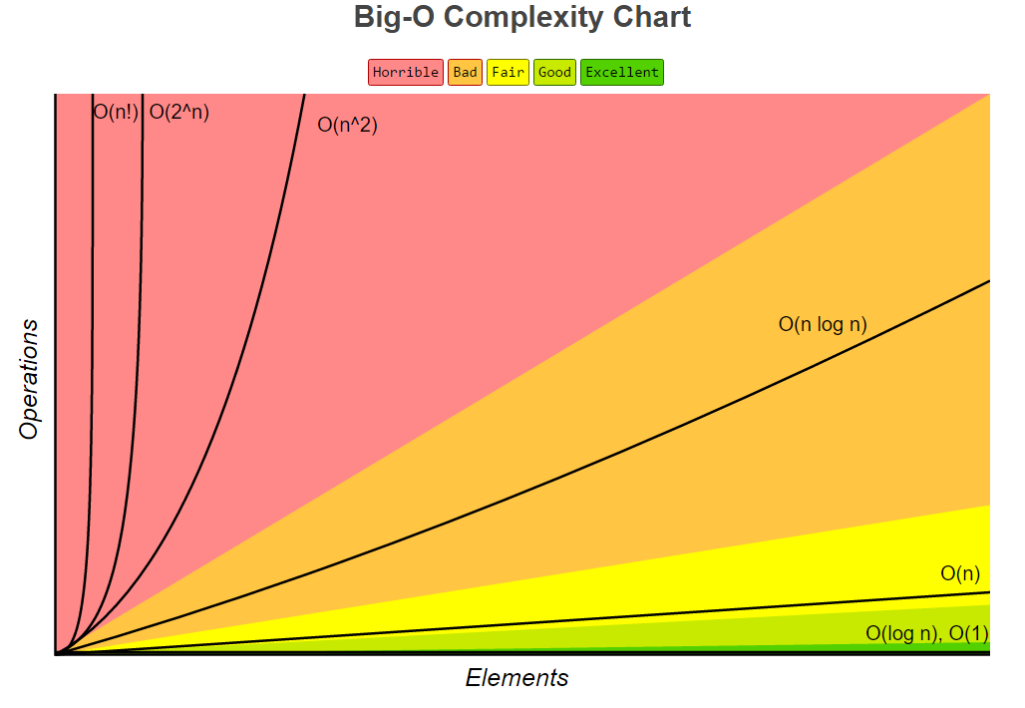
Being fast by not being stupid

Slide 9

Didn’t we already do that?
We had O(N^3) in the code
O(N^2) is for armatures, it seems
We fixed that

Slide 10
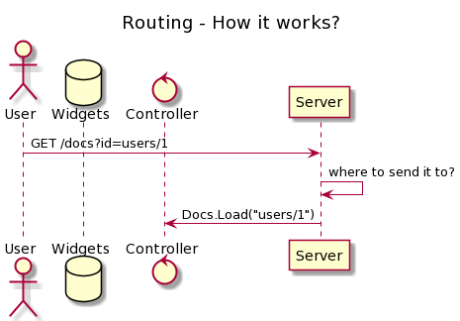

Scenario 1: Routing requests…
GET /docs?users/1
DocsController.Load(“users/1”);
What is the cost?
100 clients – 5,000 reqs each
ASP.Net (2016) - 15,151 hits/sec
NancyFX (2016) - 23,364 hits/sec
Uses trie

Slide 11
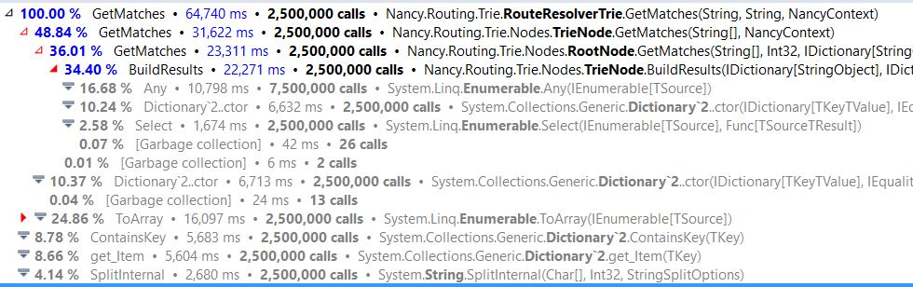
Where are the costs?
return this.routeTries[method] .GetMatches(path.Split(splitSeparators), context)
.ToArray();
Allocation
Allocation

Slide 12
Implementing carefully…
Embrace limitations
Measure
Apply techniques:
Algorithms
Caching / memorization
Trade memory for time
400 routes - cheap
ASCII only
Assume (mostly) fixed paths
Adjust to user input
No allocation allowed
Really annoying code

Slide 13
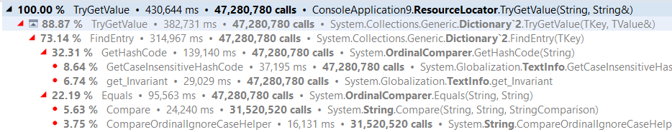
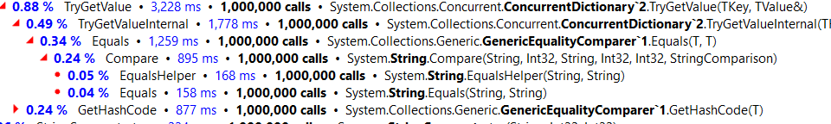
Case insensitive routing
http://goo.gl/wv9DpX

Slide 14



Routing – Over time…
2,300%
648,000%
2,800%
Less than 1 μs per call under profiler

Slide 15
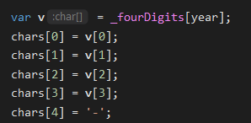
Scenario 2: Date formatting
Specialization for the max
RavenDB date format:
yyyy'-'MM'-'dd'T'HH':'mm':'ss.fffffff
2015-01-15T00:41:16.6616631
dateTime.ToString(Format, CultureInfo.InvariantCulture)
~750 dates / ms
GetDefaultRavenFormat() – dedicated method
~4,850 dates / ms
Single allocation cost

Slide 16
Scenario 3 - ∞: Can’t do it like this…
Small code changes can have major impact on the system, but will hit a wall at some point
Need something better, need to change the architecture itself
For a database, what does this looks like?

Slide 17
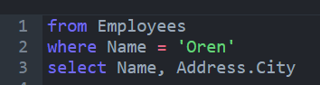
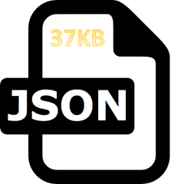
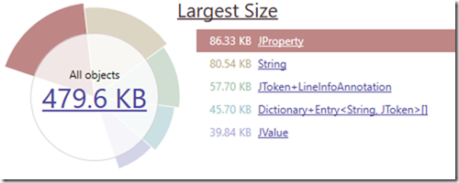
Make this query faster
What is involved?
Find the right document (index)
Load the document from disk
Parse the document
Extract values
Return to user
Allocation: byte[]
Allocation: JObject #1
Allocation: JObject #2
Allocation: string

Slide 18
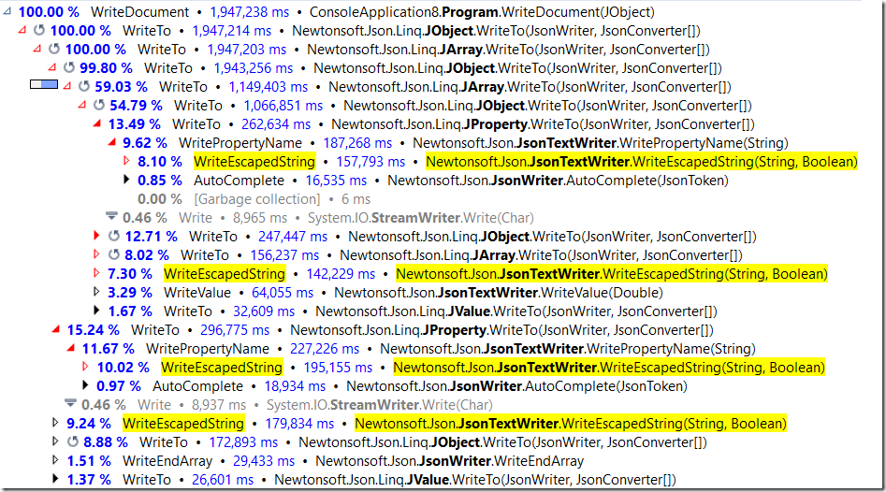
What’s the cost of writing JSON?

Slide 19
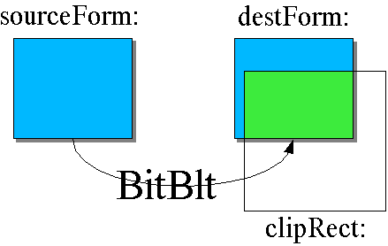
The Blittable format
Random access
Use unmanaged memory
Pointer arithmetic access
No parsing
Once loaded, zero cost to use
Self learning

Slide 20
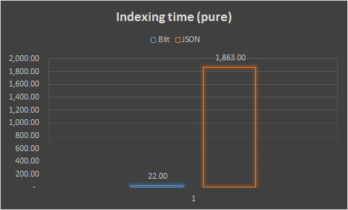
Blittable cost comparison

Slide 21

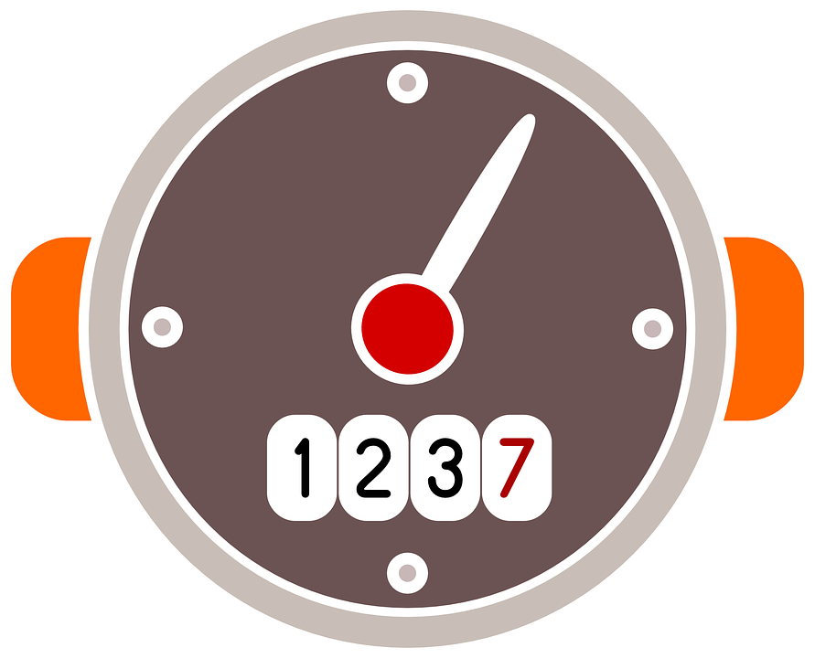
JSON Parsing
Can’t pay the parsing cost (over & over)
Own binary format, optimized for retrieval
Context will retain knowledge of parsing behavior
Context is reusable
You get faster over time

Slide 22

Zero copy model
I/O is expensive – so use buffers
Buffering is complex / hard to manage & operate
Literally multiple PHD level stuff to get right
Instead, mmap() your data file
Data will be paged in by the OS
Buffering managed by the kernel, global view

Slide 23

Mmap() + blittable
Get a pointer to a blittable document buffer
On access, if needed, OS will load to mem
Usually, will reside in memory already
Hot data is handled for free ☺
Can operate on the raw memory with no additional work

Slide 24

Get document
Async I/O via Kestrel
Storage – gimme doc whose id is “users/1”
Storage gives back 0x4E18F0A29E1DE48B, size: 4,814
Write to network (Async I/O)
Kernel handles caching of disk data

Slide 25

Memory handling
Understand the GC
No allocations – best
Very long lived allocations - fine
Very short lived allocations – okay
Midlife crisis & allocations – I already said crisis, right?
Take direct ownership
The context idea

Slide 26

See the code that isn’t there?
Understand what is going at a lower layer
Figure out how to take advantage
Reap the benefits ☺

Slide 27
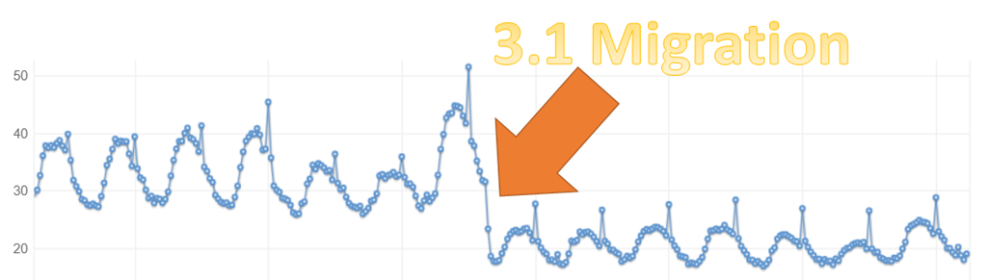
Pick the environment
Same lessons we learn (allocation, performance)
DNX → .NET Core → .NET
Minor changes → avalanche
Not isolated incident 👇

Slide 28
Questions?

